Slide 1
WORLD'S REAL ESTATE DATA
WORLD'S REAL ESTATE DATA
Presented by:
Fatima ammar - Zahra Hussain - Mariam alkangooni

Slide 2
PROBLEM STATEMENT:
It’s hard to understand what makes real estate prices go up or down, especially when comparing properties across different countries. With data from REALTING.com, which includes property details from around the world, we have a chance to explore what affects prices, spot global trends, and even predict future values. This analysis can help buyers, sellers, and investors make smarter real estate decisions.
AIM:
To analyze global real estate data and find how location, size, and other features influence property prices, helping buyers make better decisions.

Slide 3
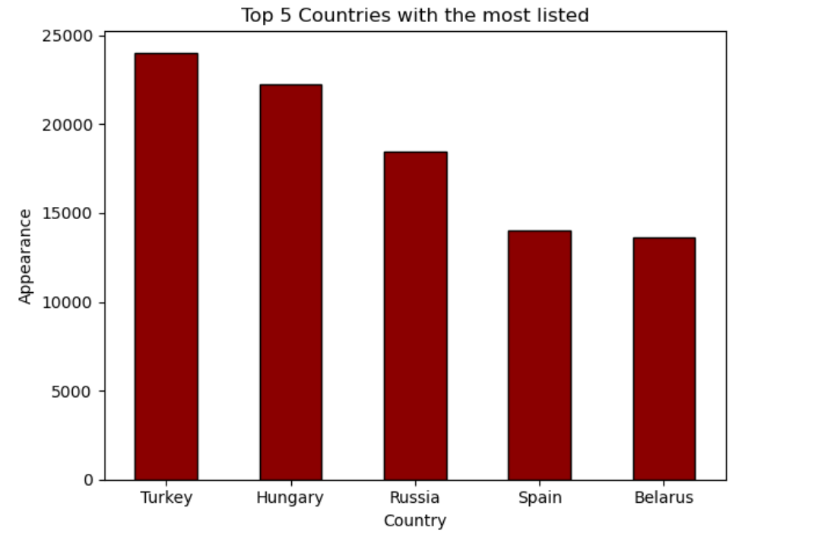
TOP5 COUNTRIES WITH THE MOST LISTED

Slide 4
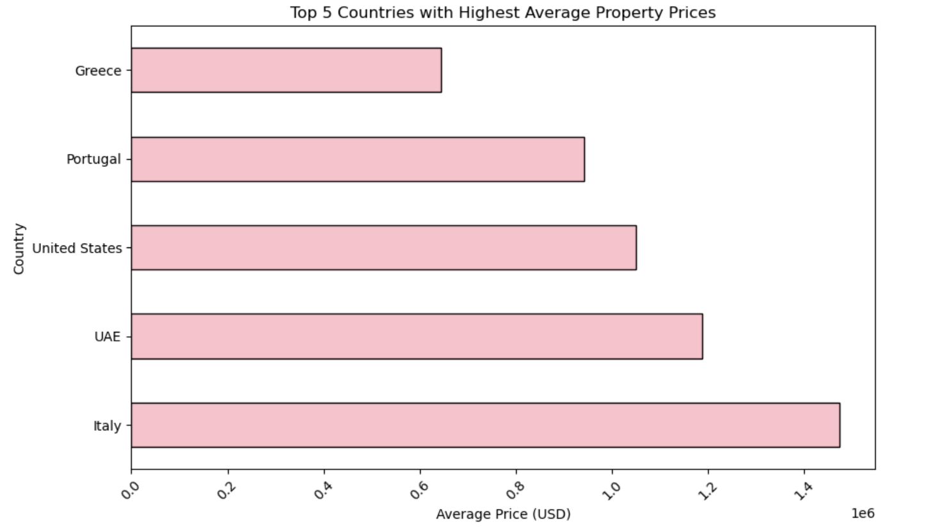
TOP5 COUNTRIES WITH THE HIGHEST AVG PROPERTY PRICE

Slide 5
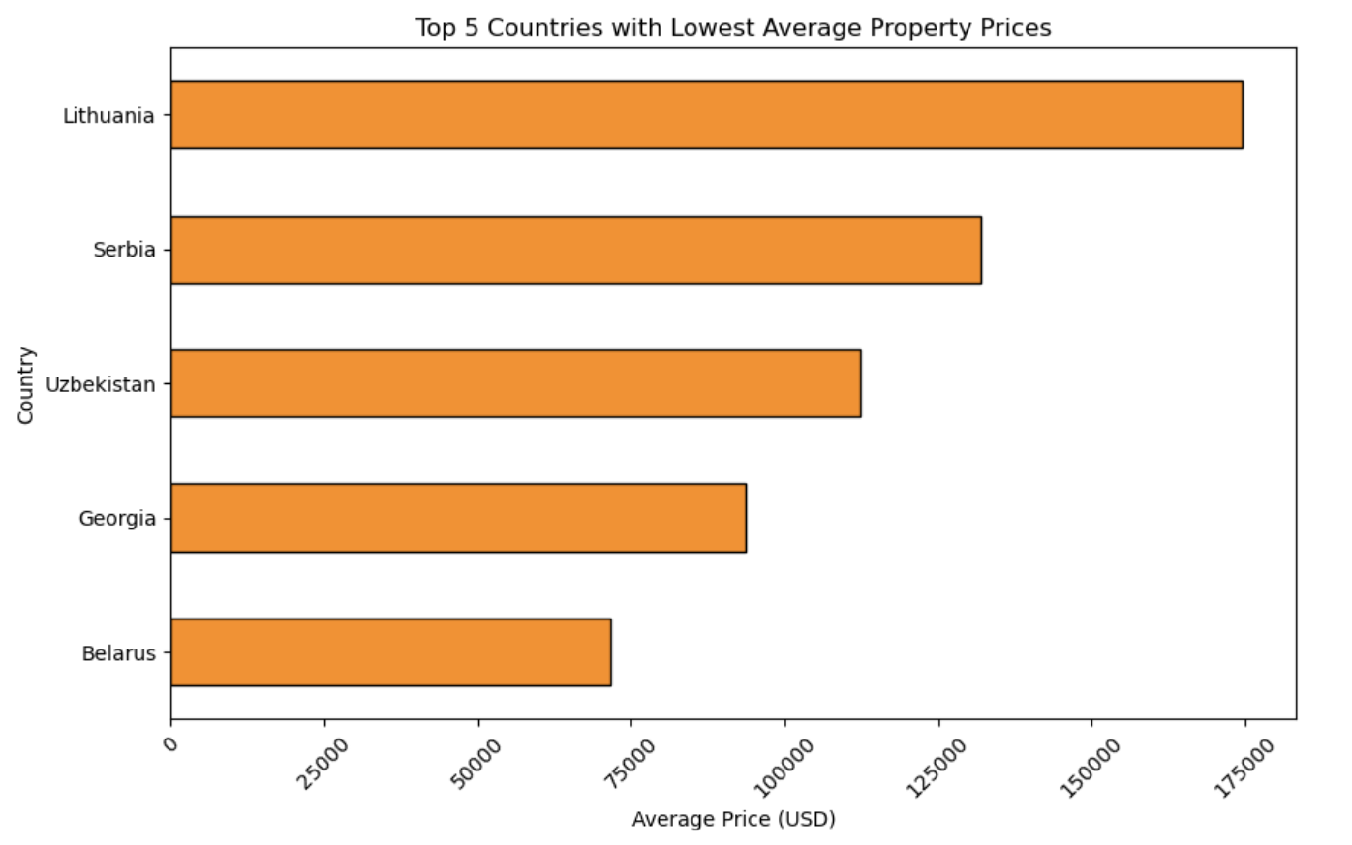
TOP5 COUNTRIES WITH THE LOWEST AVG PROPERTY PRICE

Slide 6
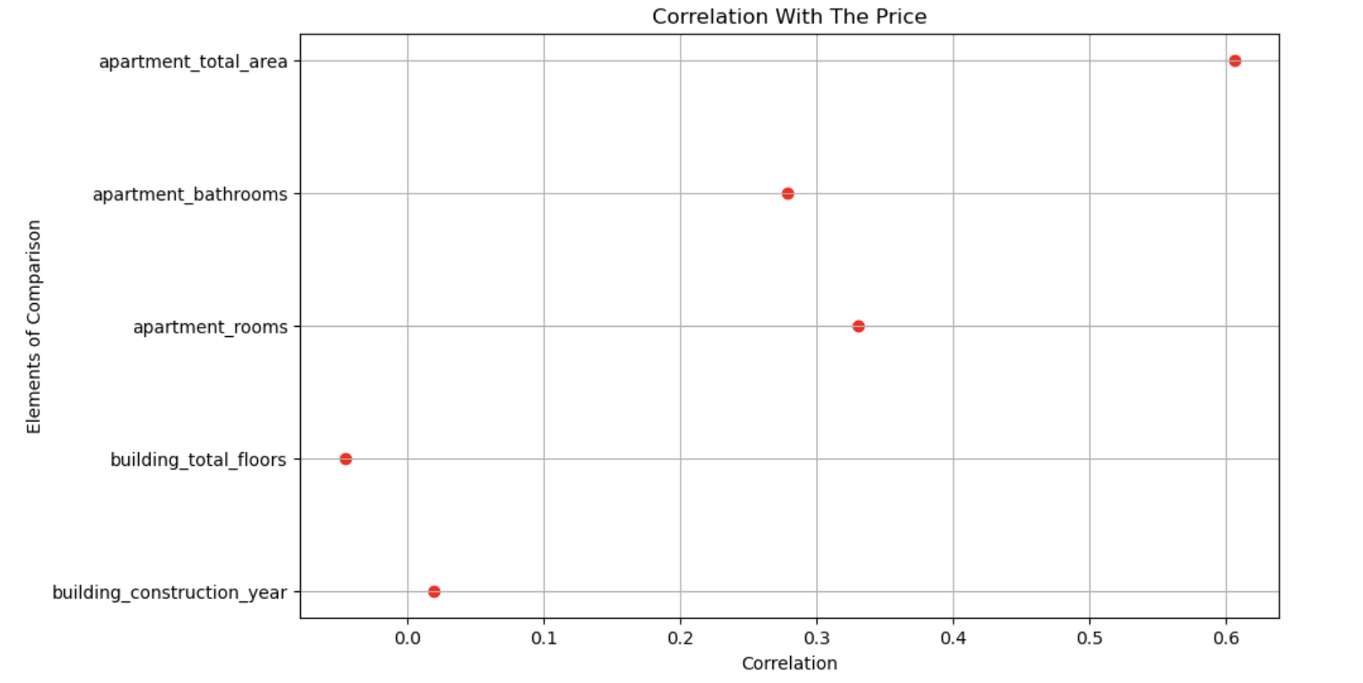
CORRELATION BETWEEN PROPERTY ATTRIBUTES AND PRICE

Slide 7
RECOMMENDATIONS:
• Target countries with lower average property prices for better investment options.
• Look for properties with larger areas and more rooms, as they are usually more valuable.
• Use feature-price correlations to guide property evaluation.
• Always compare prices across countries to spot market differences

Slide 8
THANKS!

